Slide 1

Tutorial on plotting with OpenCOR
https://opencor.ws/app
Author: Alan Garny, Auckland Bioengineering Institute

Slide 2













Mechanics example
Mass/spring/damper system
Bond graph model
$$C:q_{C}^{m}$$
R
$$u_{C}^{m}$$
$$u_{R}^{m}$$
$$v_{C}^{m}$$
$$v_{R}^{m}$$
C
R
$$u_{C}^{m}$$
$$v_{1}^{m}$$
$$u_{R}^{m}$$
$$u_{L}^{m}$$
$$u_{L}^{m}$$
$q_{1}^{m},v_{1}^{m}$
L
$$v_{L}^{m}$$
L$:{\dot{v}}_{L}^{m}$

Slide 3
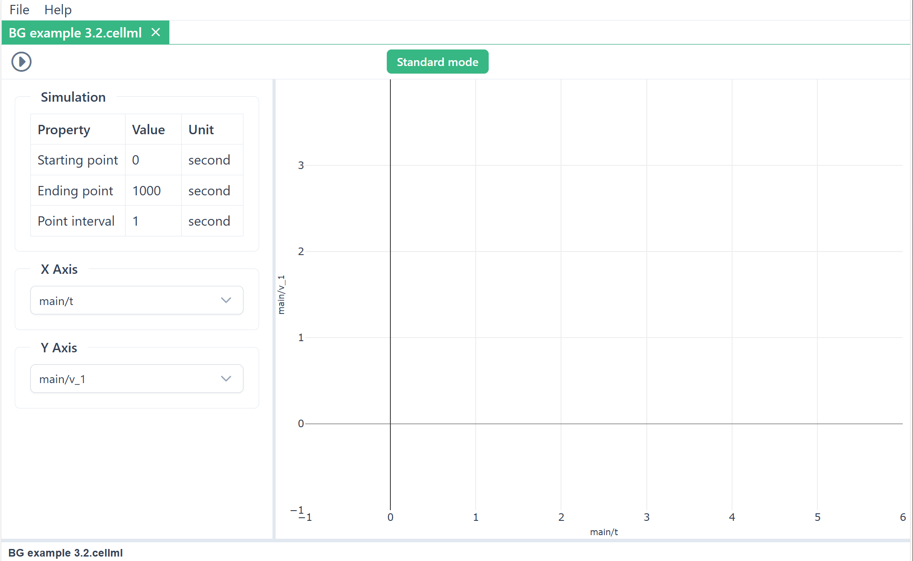
1. Drag & drop your .cellml file onto https://opencor.ws/app
e.g. Dropping this CellML file onto the app gives this

Slide 4
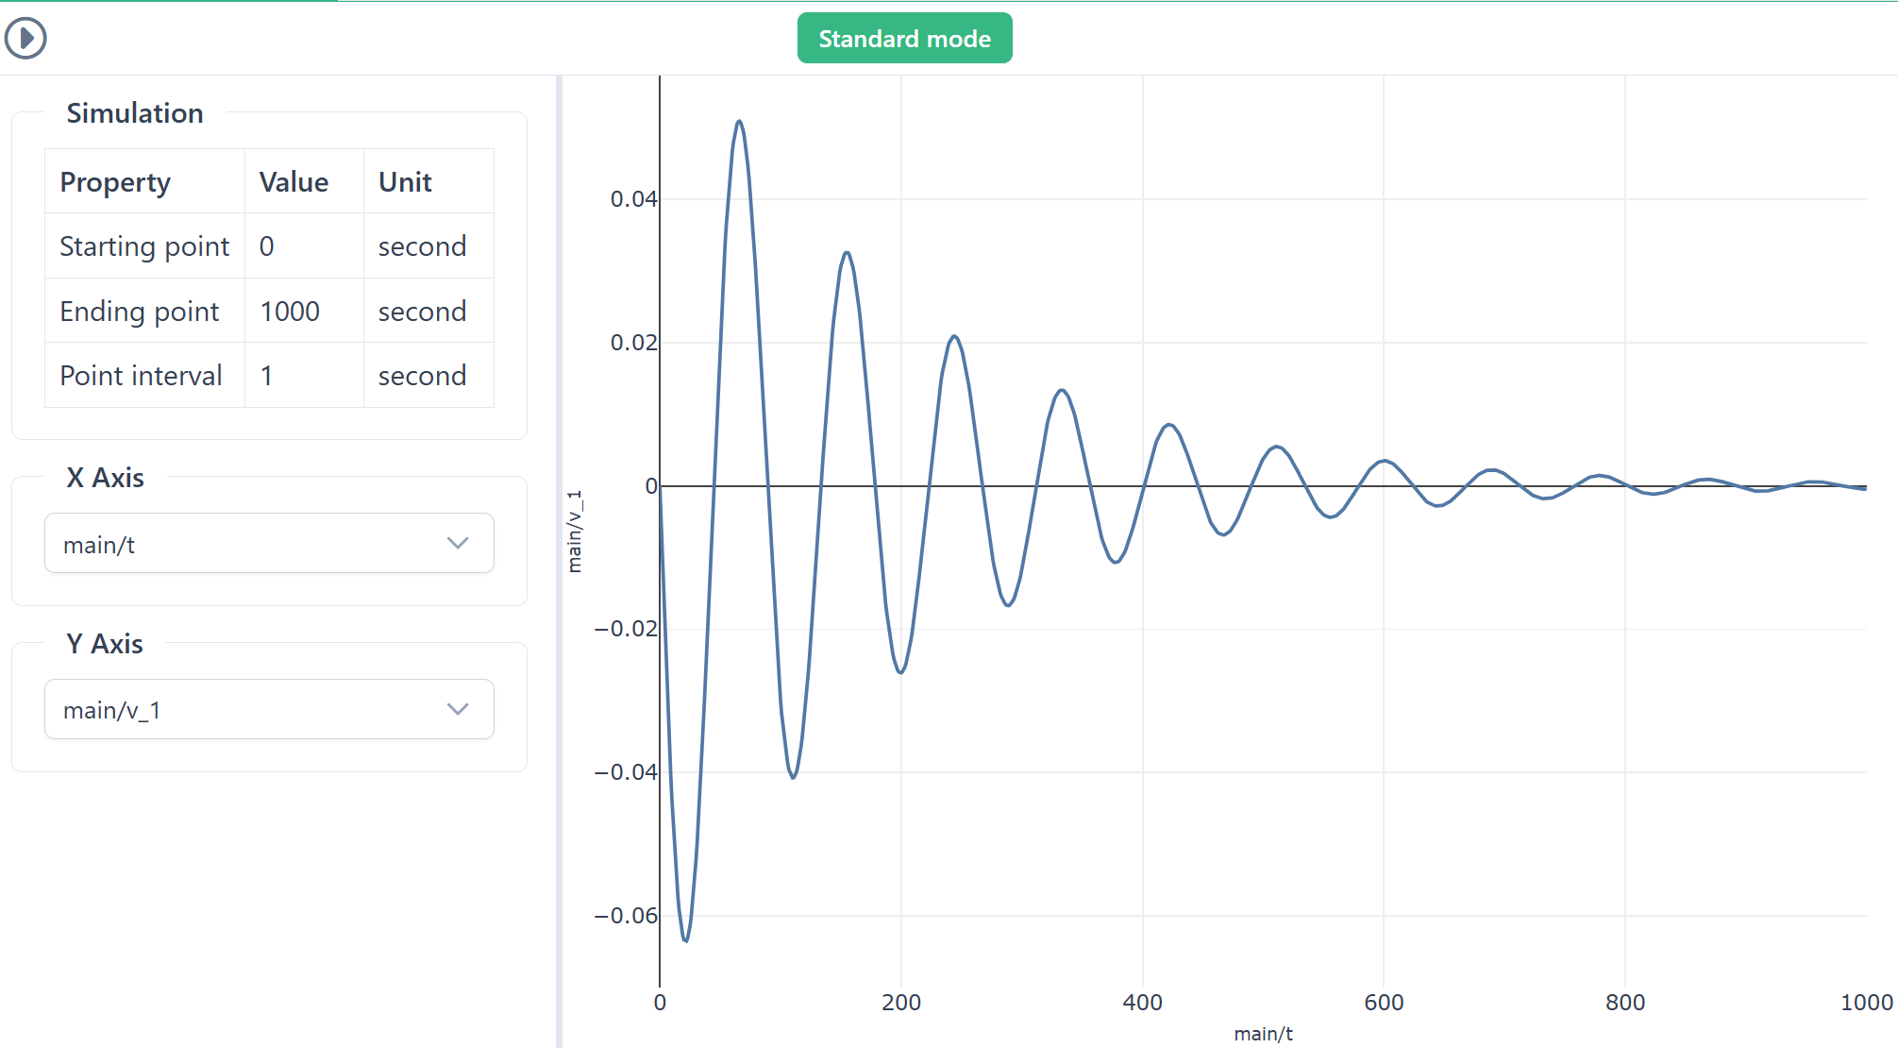
2. Run the model in ‘Standard mode’
Click on Run button
Click here to switch modes
This uses default plotting parameters

Slide 5
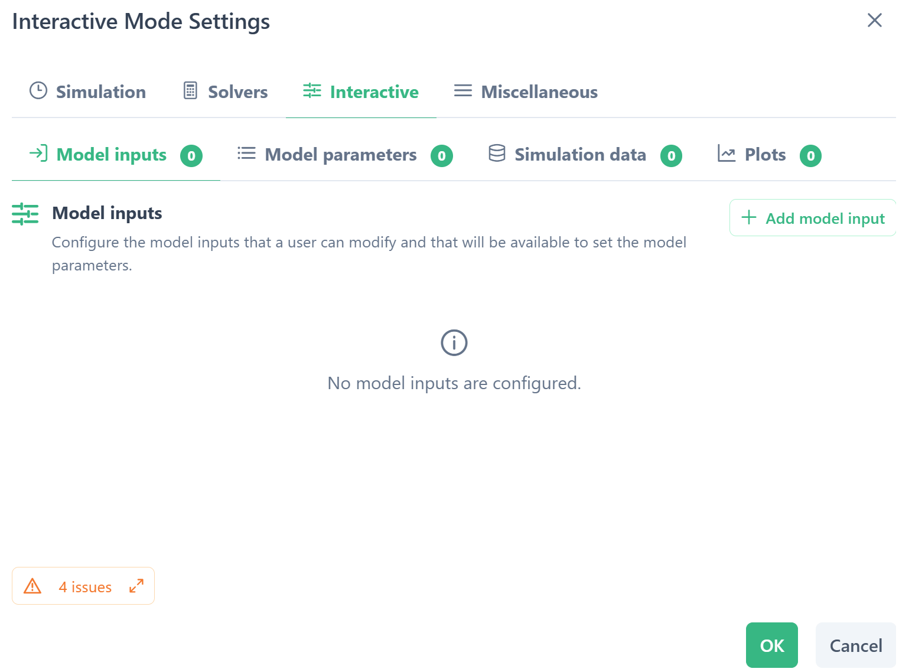
3. Interactive mode plot settings
Interactive mode
.. then requires Settings
c

Slide 6
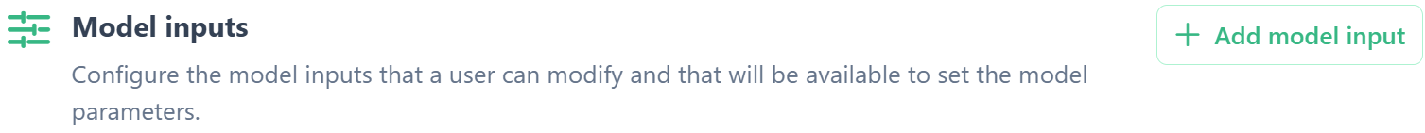
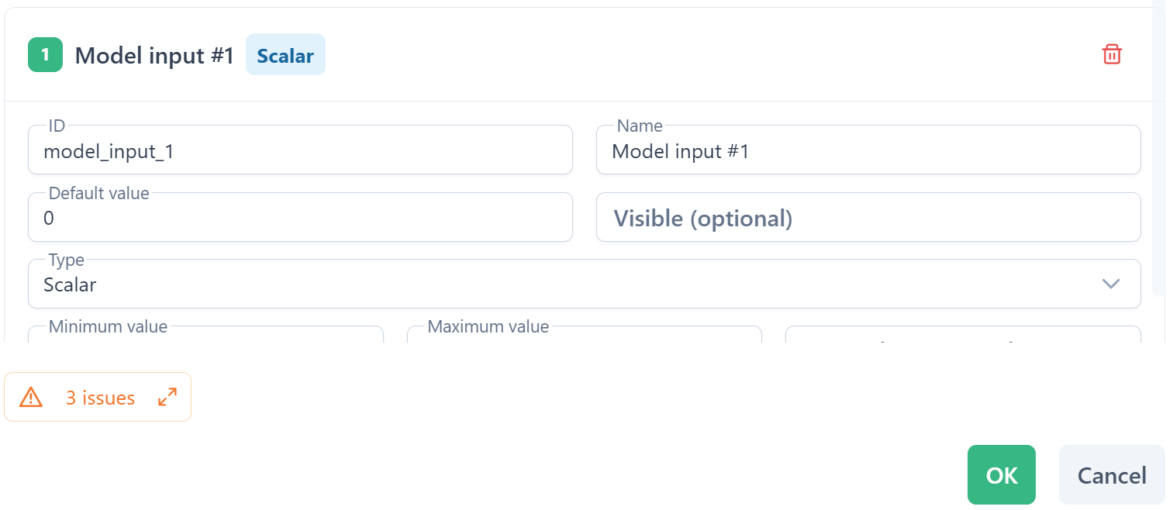
Simulation inputs
Configure the simulation inputs that a user can modify and that will be available to set the model parameters

Slide 7
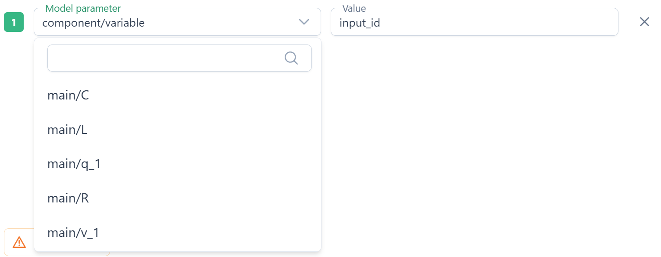
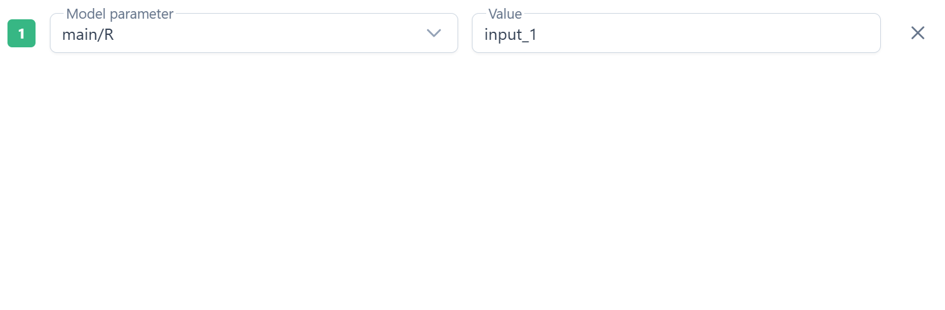
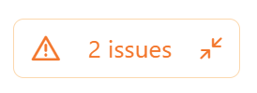
Model parameters
Choose the model parameters using the value of the simulation inputs

Slide 8
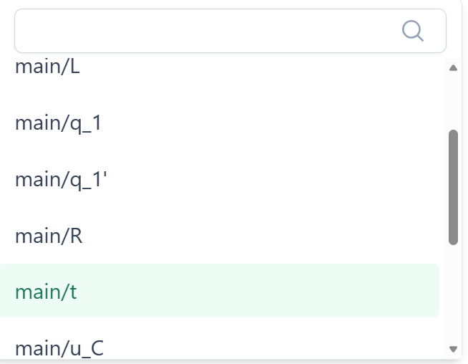
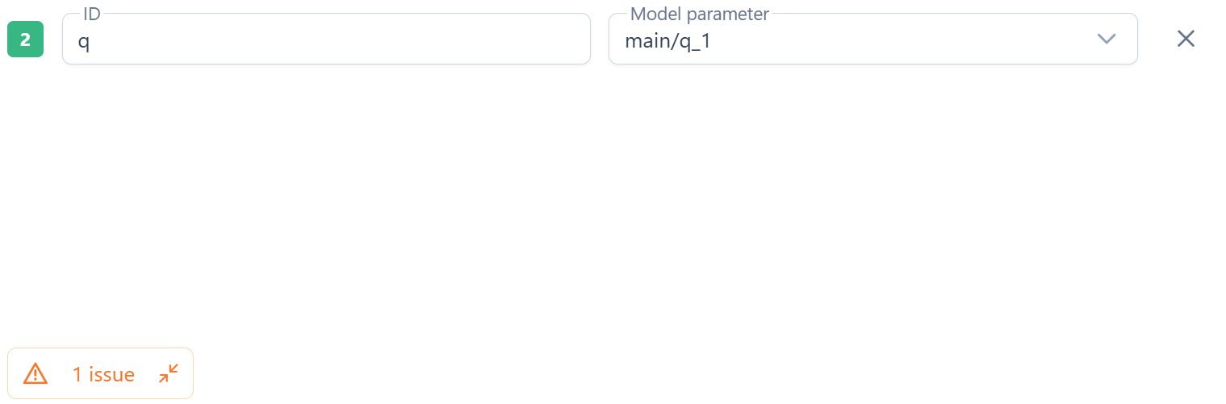
Simulation data
Choose the model output data for plotting

Slide 9
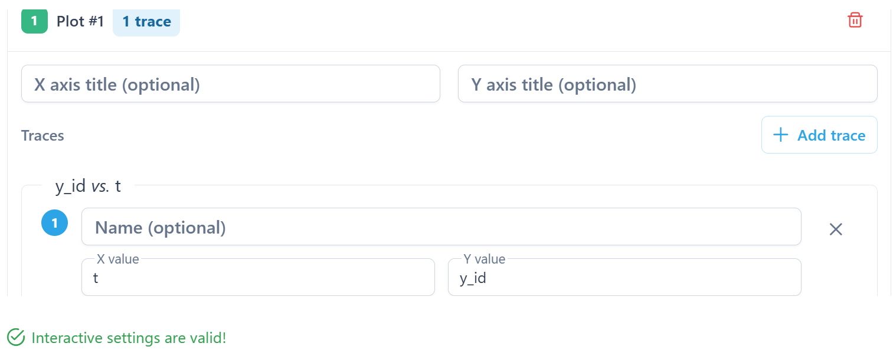
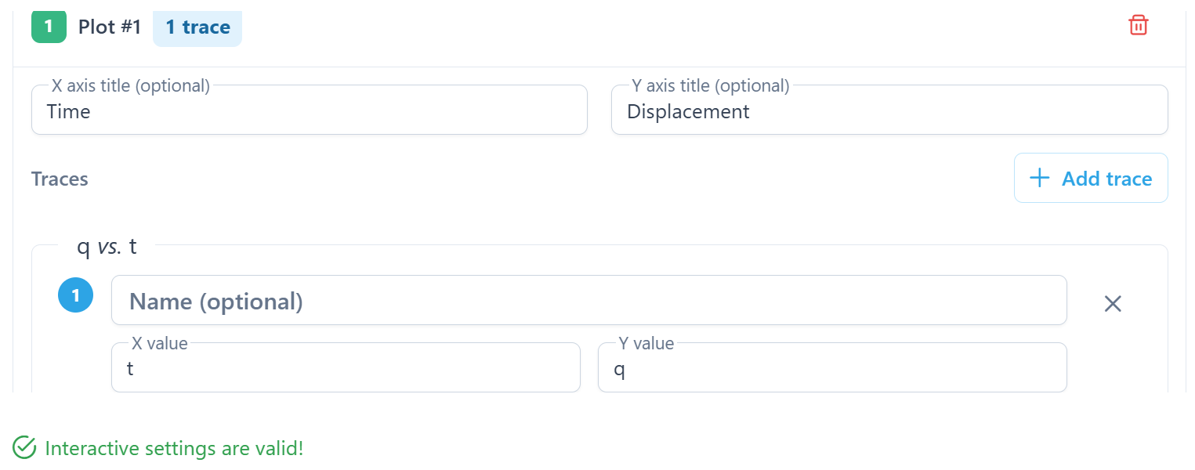

Plots
Configure the plots and traces within each plot using the simulation data
Plot configuration complete

Slide 10
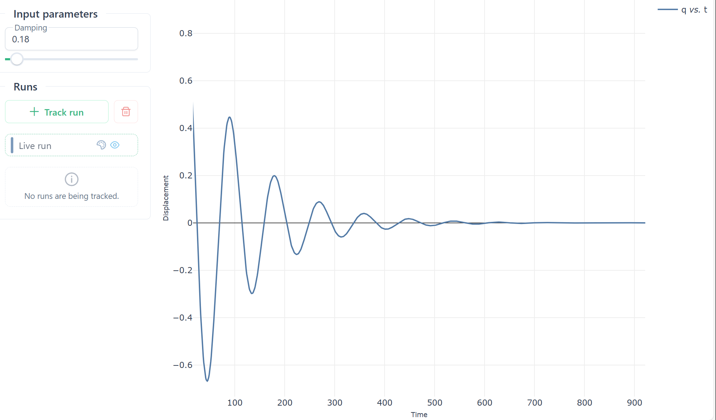
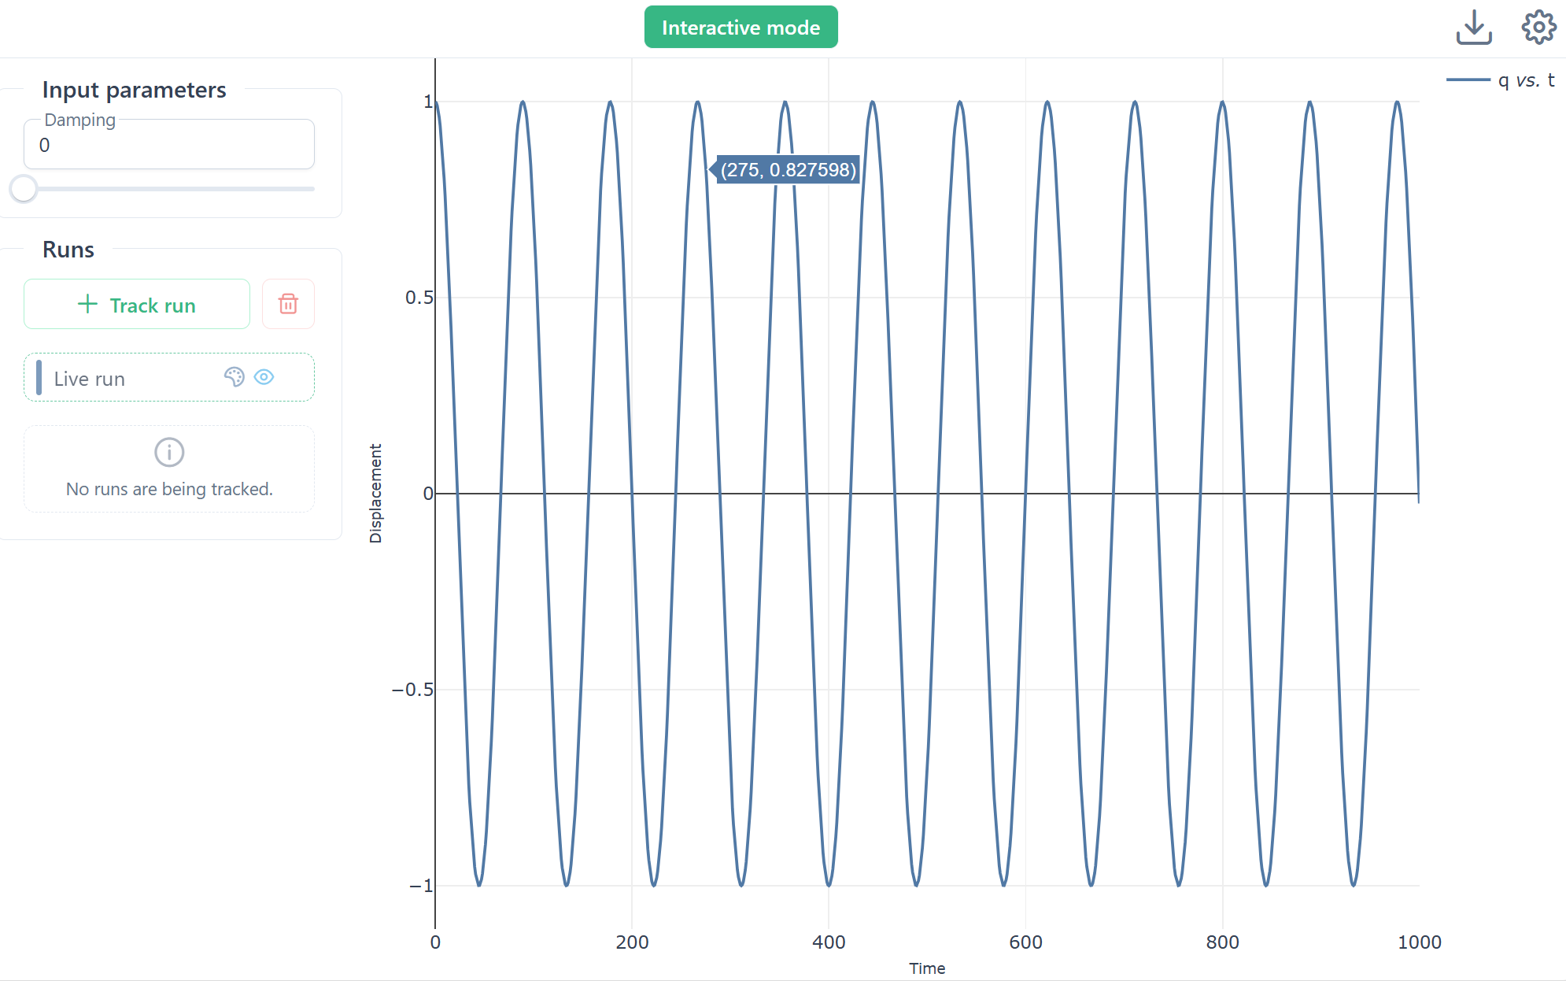
4. Interacting with the model
Input controls

Slide 11
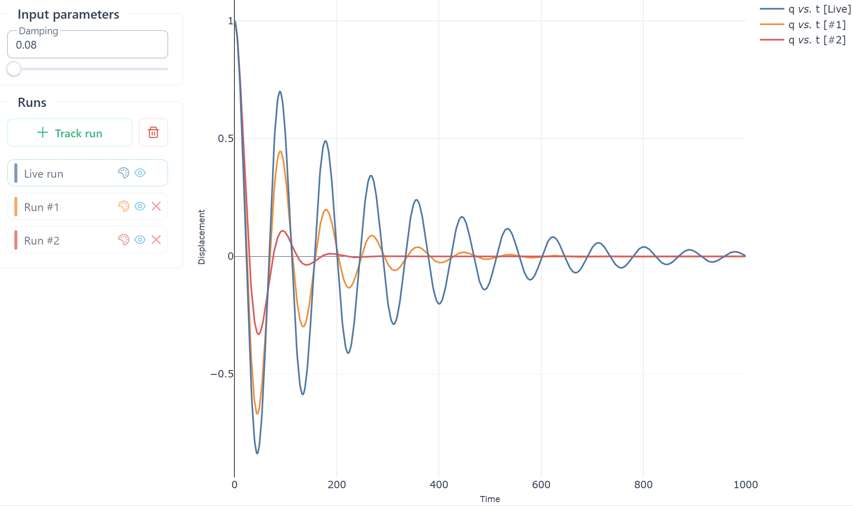

5. Retaining solutions & saving model + plot config
Save .omex file
Hide, delete, set colour

Slide 12
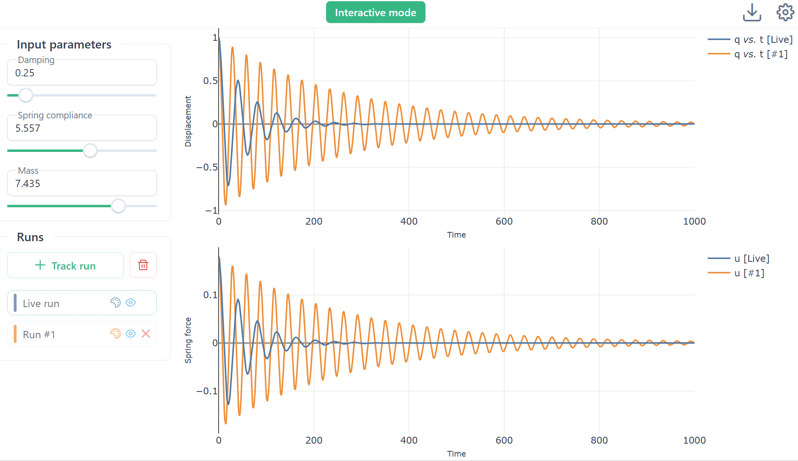
6. Adding simulation inputs and additional plots

Slide 13
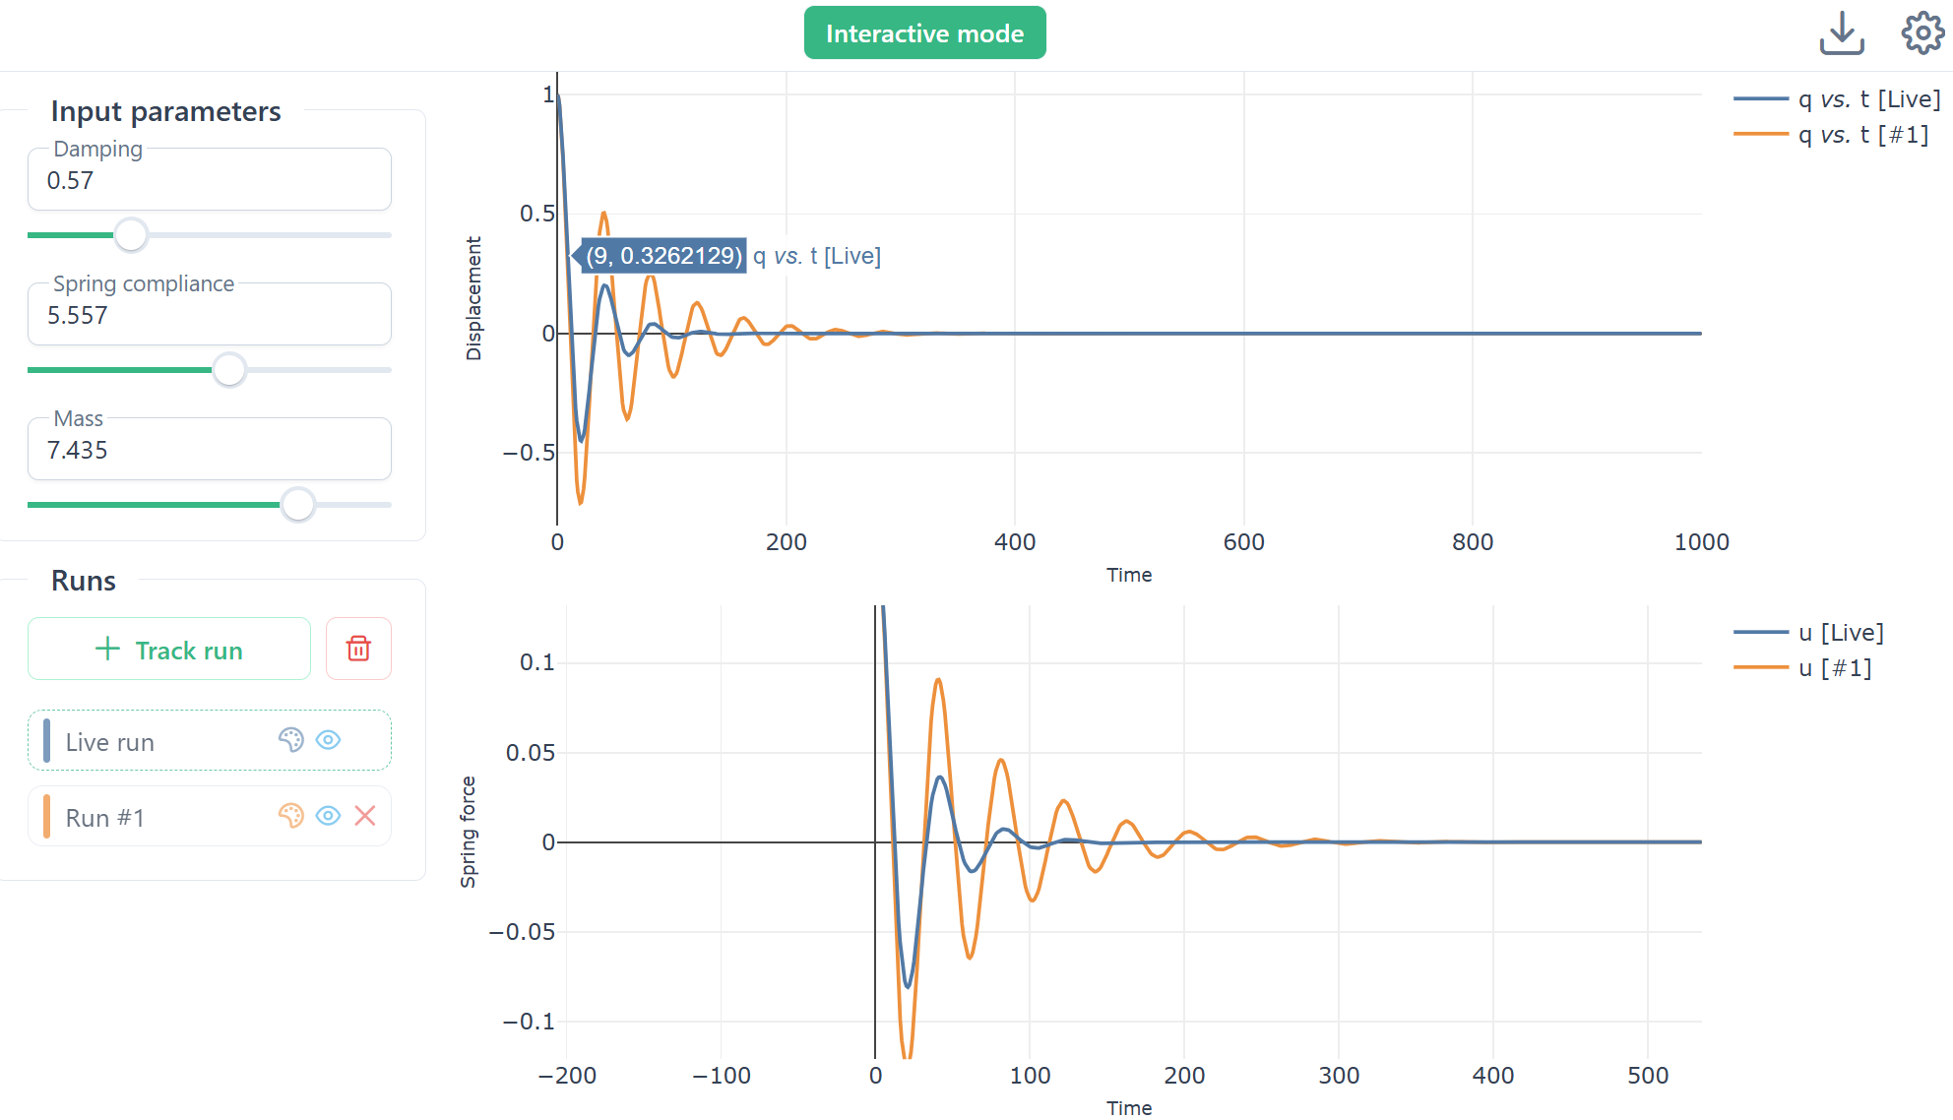
7. Zooming & panning
Usual web controls for zooming & panning

Slide 14
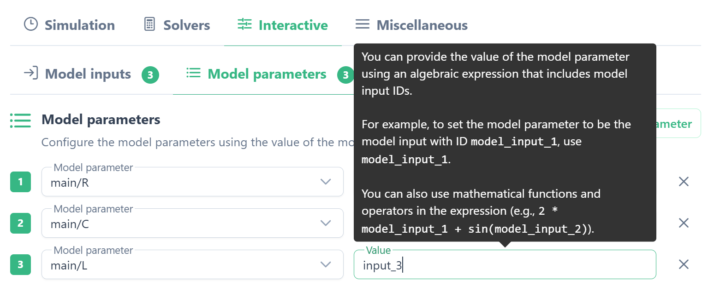
8. Advanced features

Slide 16
Tutorial on CellDL bond graph editor
CellDL
https://celldl.github.io/CellDLEditor
Author: Dave Brooks, Auckland Bioengineering Institute

Slide 17
Mechanics example
Mass/spring/damper system
Bond graph model
$$C:q_{C}^{m}$$
R
$$u_{C}^{m}$$
$$u_{R}^{m}$$
$$v_{C}^{m}$$
$$v_{R}^{m}$$
C
R
$$u_{C}^{m}$$
$$v_{1}^{m}$$
$$u_{R}^{m}$$
$$u_{L}^{m}$$
$$u_{L}^{m}$$
$q_{1}^{m},v_{1}^{m}$
L
$$v_{L}^{m}$$
L$:{\dot{v}}_{L}^{m}$

Slide 18
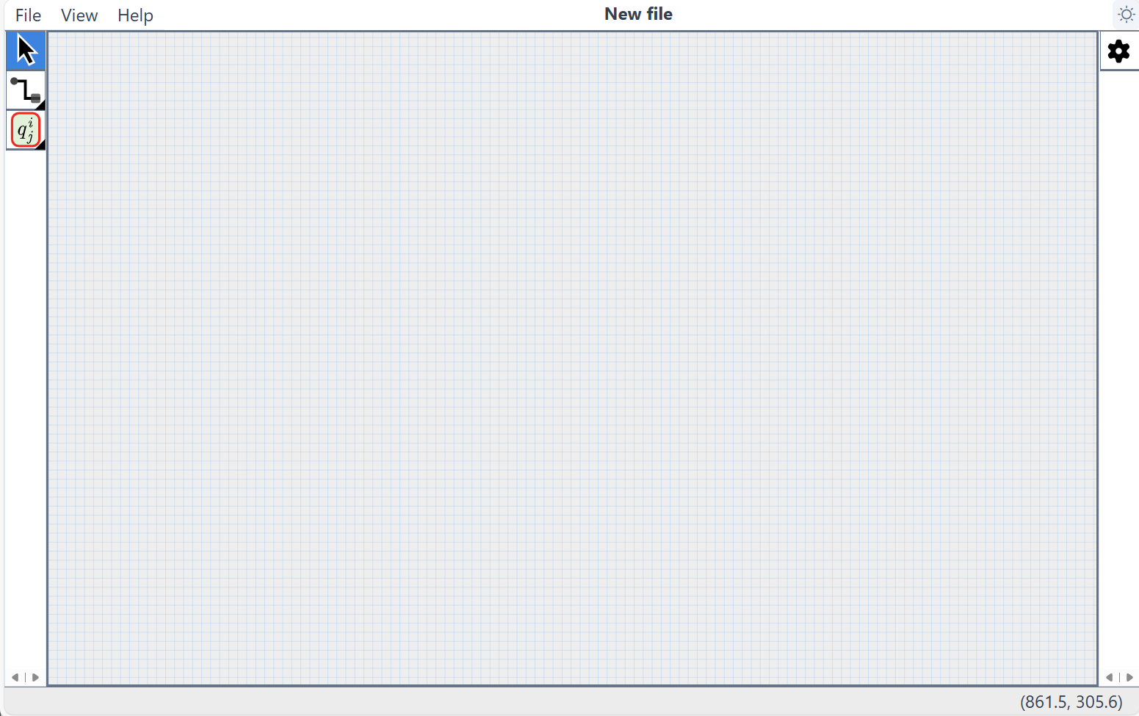
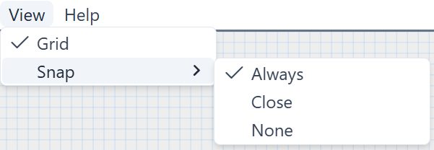
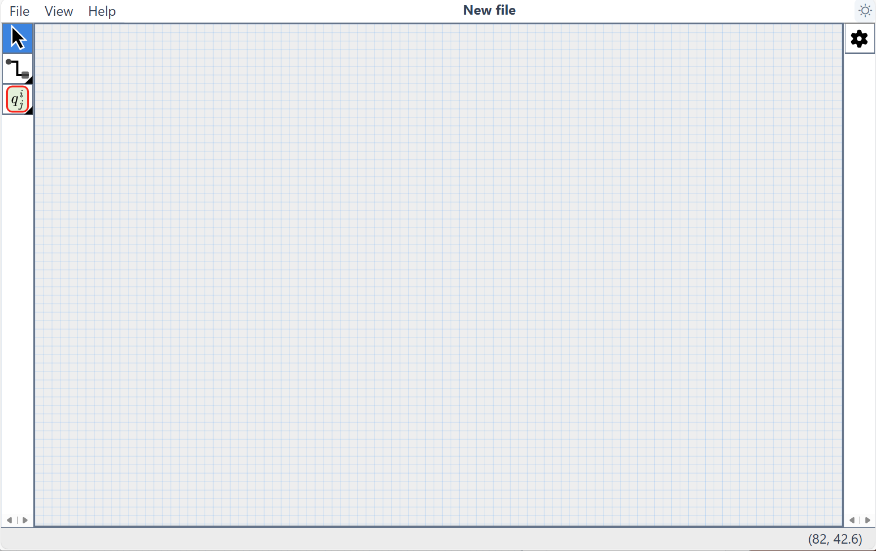
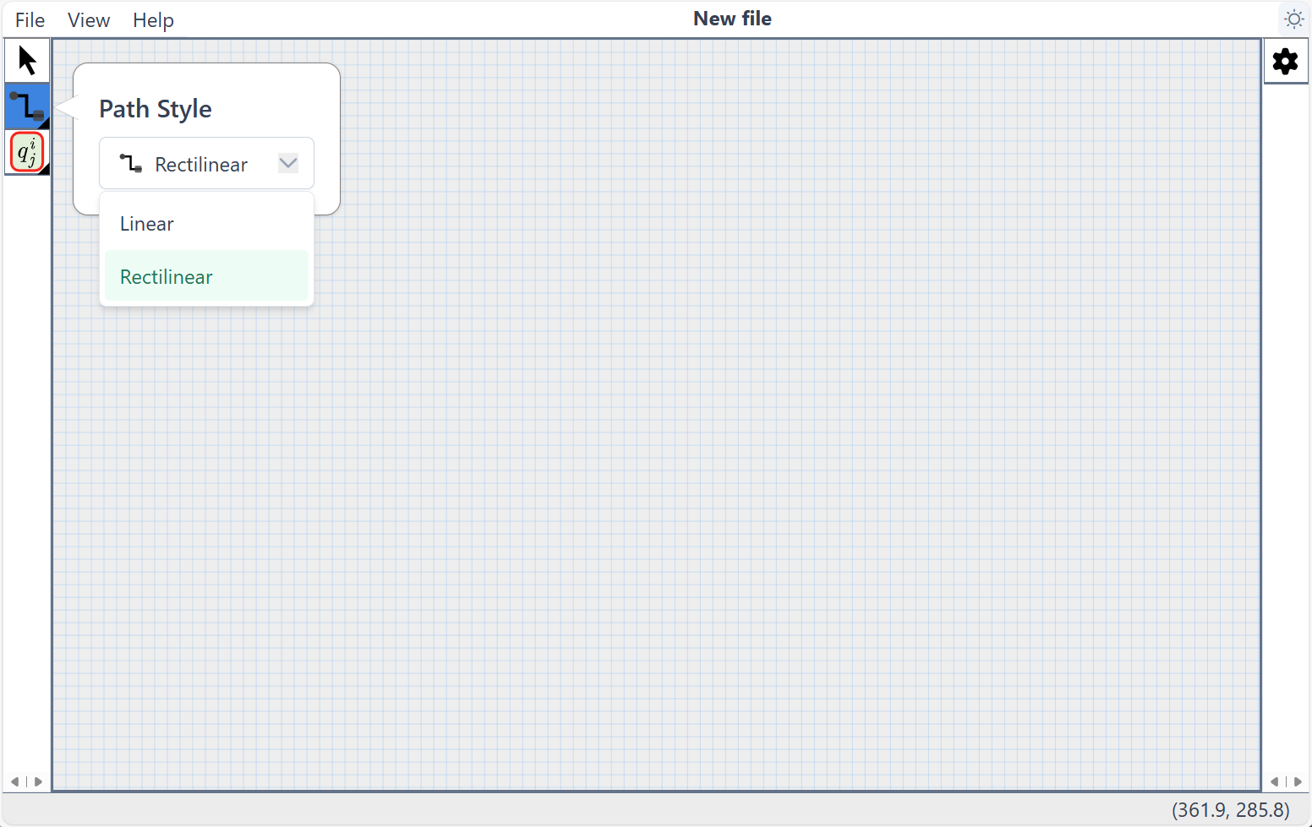
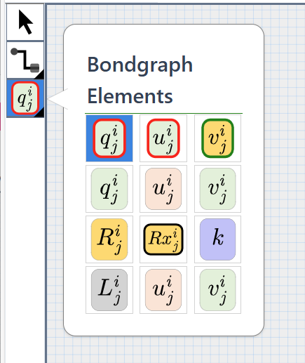
2. Open editor https://celldl.github.io/CellDLEditor
Dark mode
Selection tool

Slide 19
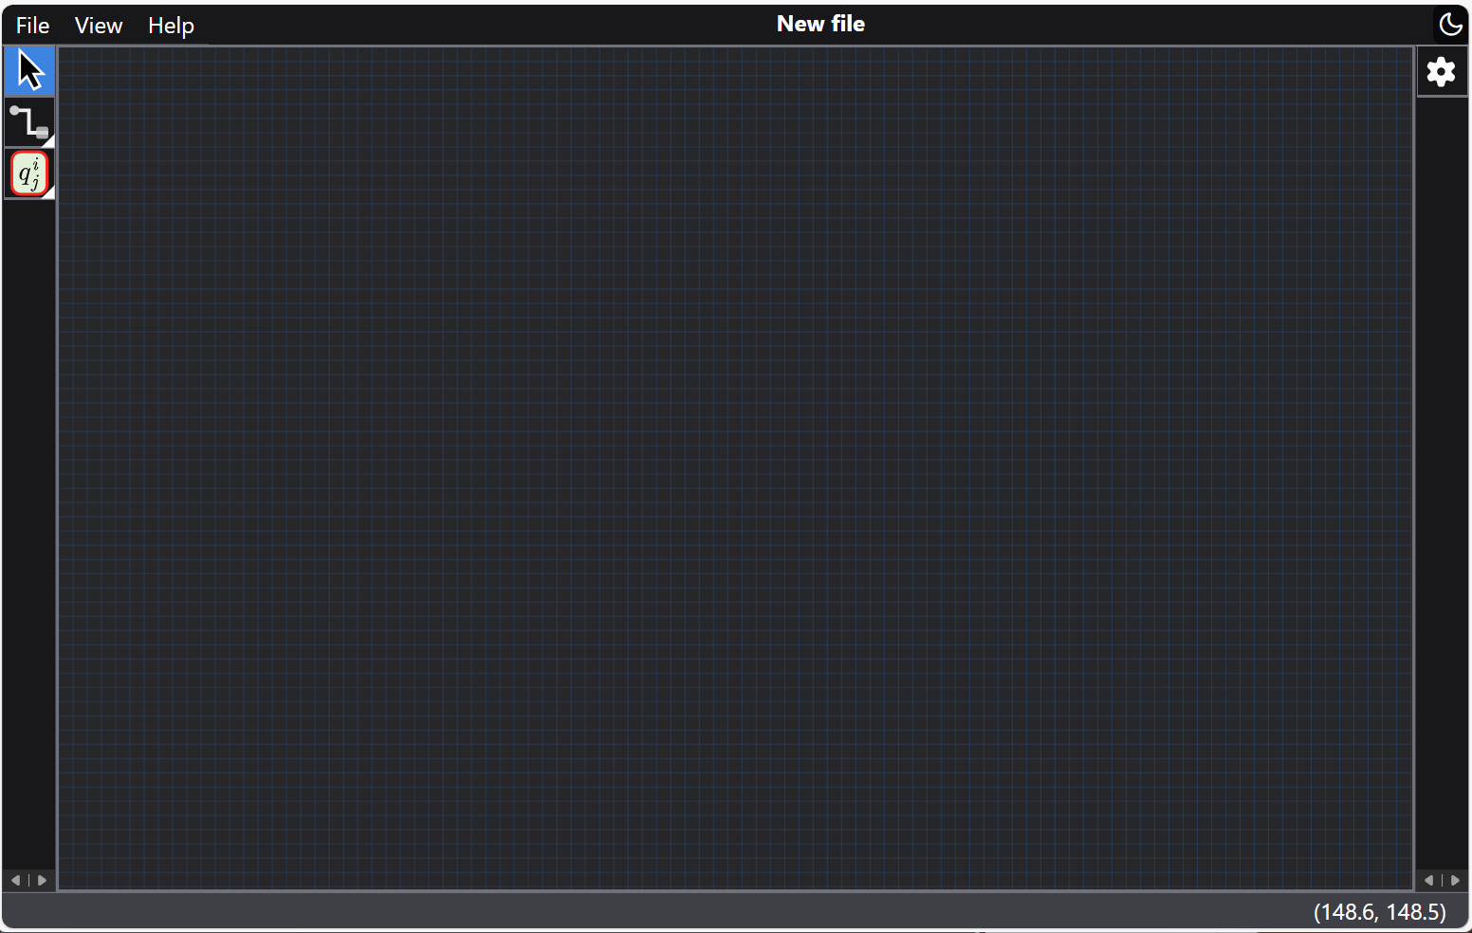
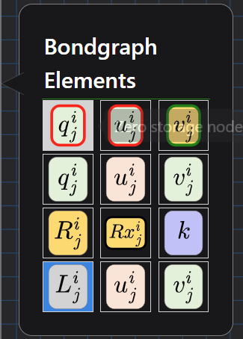
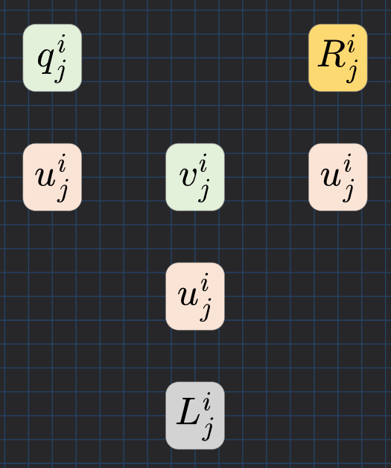
Select
Drag and drop BG components

Slide 20
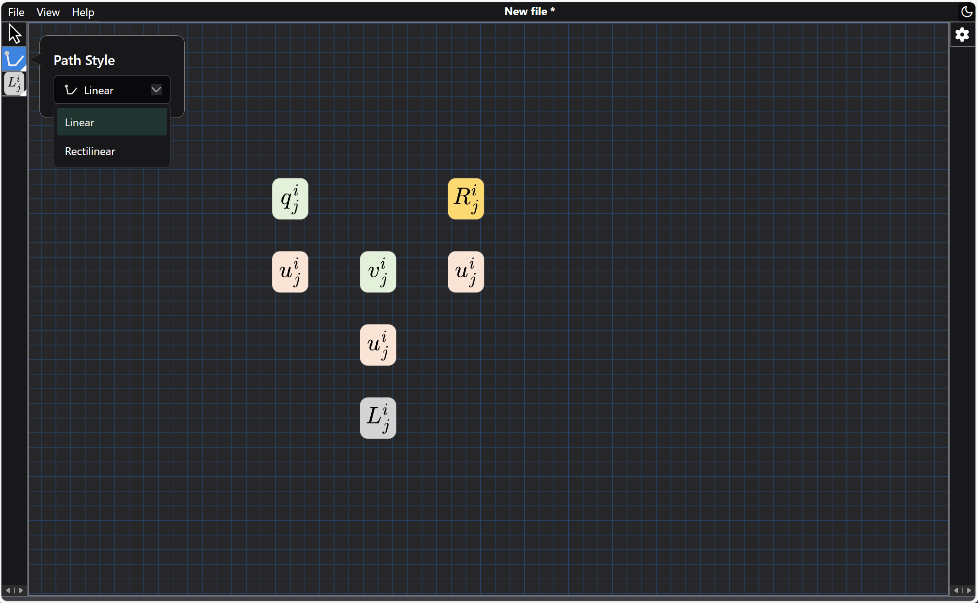
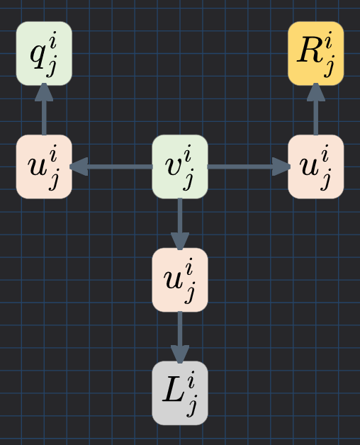
Select
Select path style
Click on 1st component then 2nd component

Slide 21
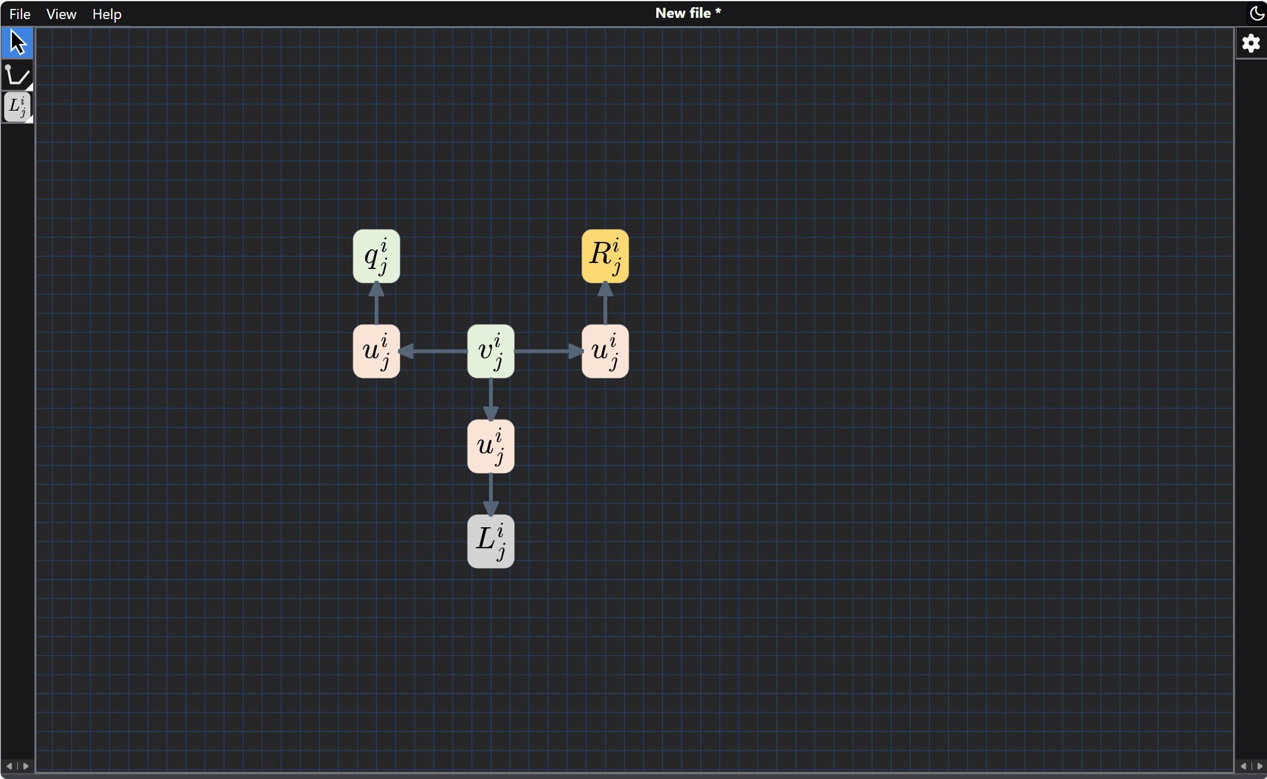
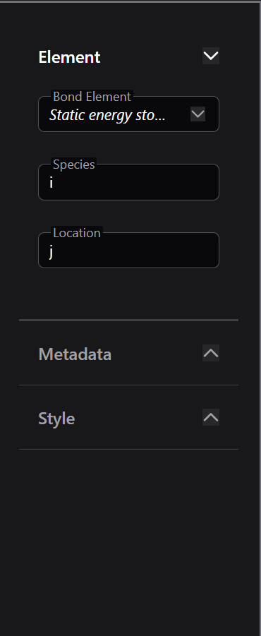
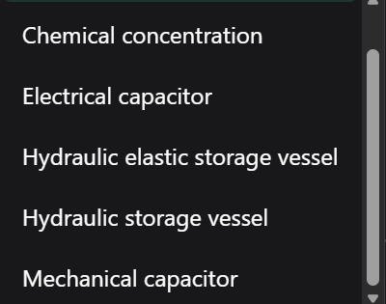
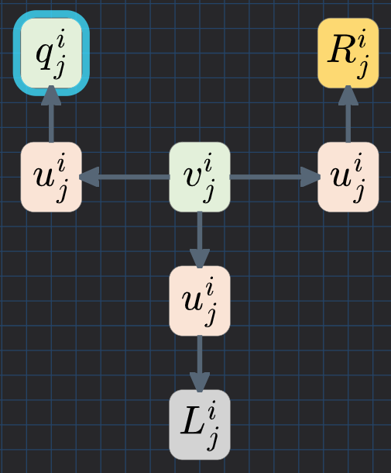
Select
Selection tool
Component properties
Select

Slide 22
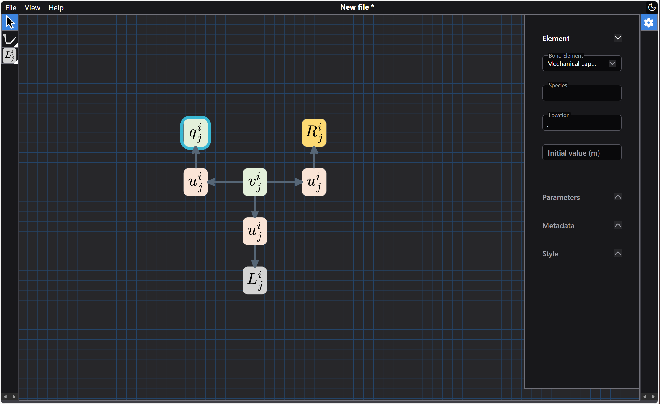
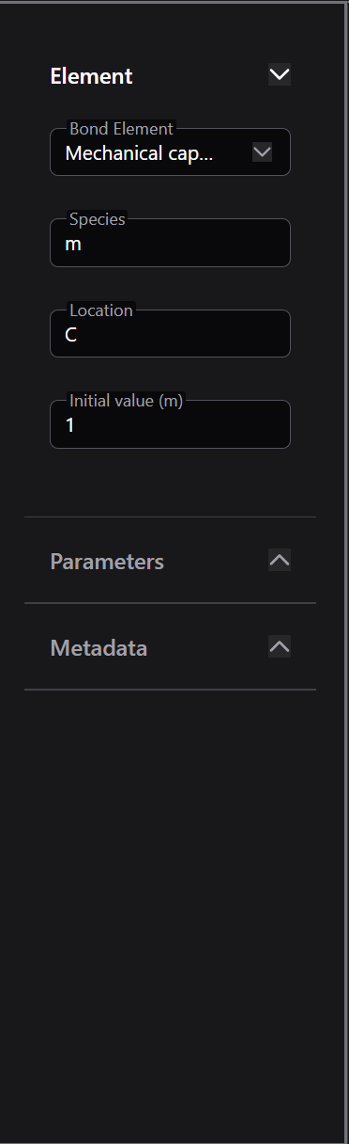
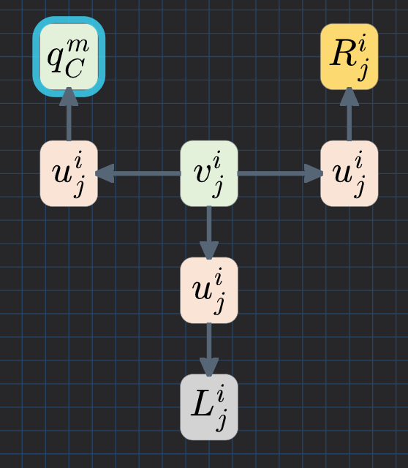
Set species,
location,
parameters
& initial value

Slide 23

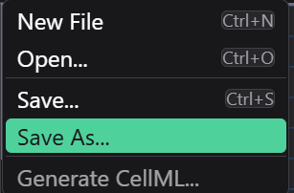
Save .celldl or .svg file
Generate .cellml file

Slide 24
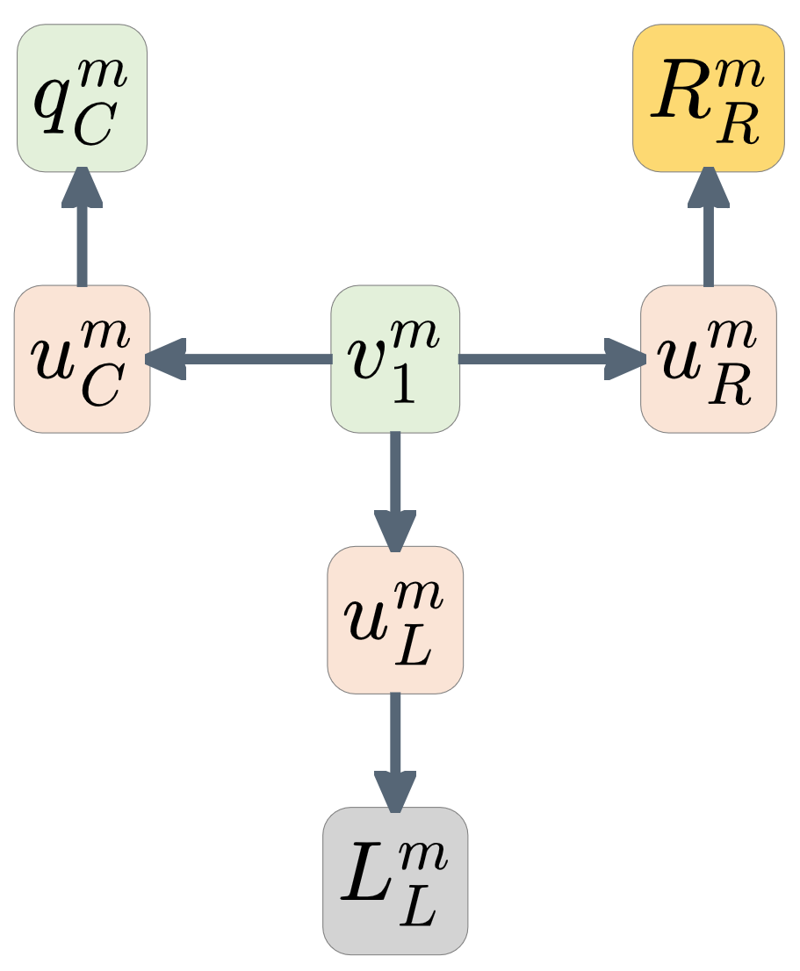
If the name.svg file is dropped onto a browser the bond graph diagram is rendered ..
If the name.cellml file is dropped onto https://opencor.ws/appdev/ the model is rendered ..

